Slide 1
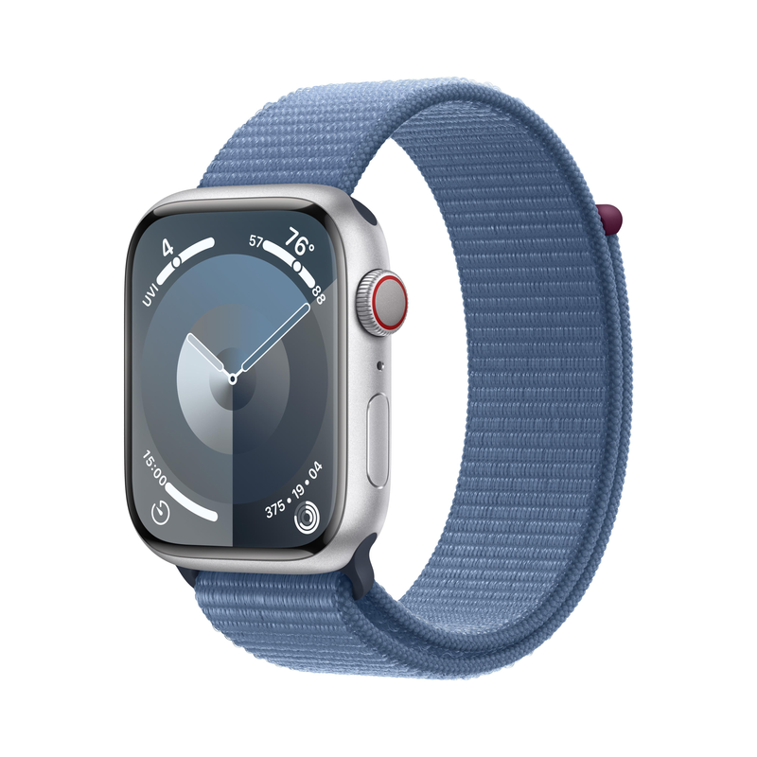
Current State of Wearable Technology in AR/VR and How My Prototype Will Differ
1. Current State of Wearable Technology
Smartwatches: Current smartwatches like the Apple Watch can track fitness, show notifications, and use voice assistants like Siri. They can monitor heart rate, steps, and sleep patterns.
AR Glasses: Devices like Microsoft HoloLens or Google Glass provide basic augmented reality features, such as displaying notifications and virtual objects, but they’re still bulky and expensive.
VR Headsets: Devices like Oculus Quest and PlayStation VR offer full VR experiences, including virtual meetings and games. They are immersive but require heavy, uncomfortable headsets.
2. AR/VR Applications in Wearables
Fitness Assistance: Some wearables track physical activity and can display fitness data through AR (like a virtual trainer) or VR (virtual fitness environments).
Virtual Meetings: VR headsets allow users to meet in a digital space, while AR glasses can display meeting participants in real life, but with limited interaction.
Emotional Feedback: Some wearables, like smartwatches, track heart rate variability to detect stress but don’t provide interactive responses, and AR/VR solutions are in early development for emotional recognition.
3. How My Prototype Will Differ
Emotion Recognition: Unlike current devices, the watch will actively respond to emotional states with personalized suggestions (like a virtual assistant or calming environment).
Virtual Rewards: The watch will offer more engaging virtual rewards (3D trophies, badges) in AR/VR, adding interactivity and gamification.
Custom Avatars: My prototype will allow users to create highly customizable avatars that are interactive in AR/VR, unlike current devices where avatars are static.
Interactive AR Notifications: Current AR notifications are limited, but my prototype will allow interactive, floating notifications that users can tap or swipe in AR environments.
Seamless AR/VR Integration: While existing devices are often separate for AR and VR, my prototype will allow seamless switching between AR and VR experiences, improving user engagement.
Fitness Assistance: The virtual fitness coach will appear directly in the user’s environment (AR) or virtual gym (VR) with real-time guidance, making fitness sessions more immersive.
4. Using the SCAMPER Tool for Ideation
S (Substitute): Replace passive fitness tracking with active virtual coaching in AR/VR for a more engaging experience.
C (Combine): Combine emotion recognition with fitness assistance—showing calming visuals or offering rewards based on emotional state and exercise progress.
A (Adapt): Adapt the virtual reward system to work not only for fitness but also for emotional and social achievements (e.g., staying calm during a stressful task).
M (Modify): Modify existing avatars to be more expressive and interactive within AR/VR, offering personalization options for both appearance and behavior.
P (Put to another use): Use AR notifications for more than just reminders—integrating them into everyday tasks, such as displaying to-do lists or appointments in the user’s field of view.
E (Eliminate): Eliminate the need for bulky VR headsets by incorporating light AR and VR experiences that use wearable devices.
R (Reverse): Instead of just using VR for gaming, reverse the concept and use it for fitness, relaxation, and real-world communication.

Slide 2
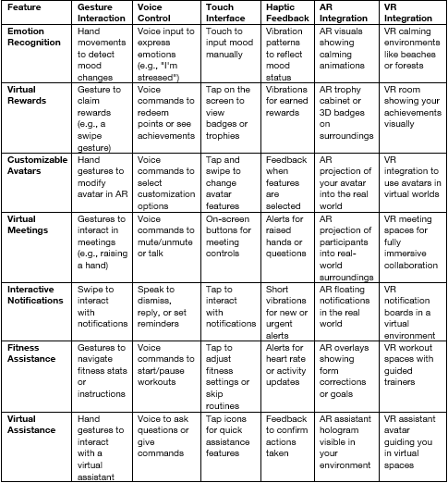
LINK
Morpho-logical Chart

